Slide 1
California Solar Permitting Guidebook
Available for Download:
opr.ca.gov

Slide 2
Purpose of the Guidebook
Help local governments simplify and standardize permitting for small solar PV projects.
Educate contractors and property owners about solar permit requirements.
Provide tips that can make permitting easier for local governments and contractors alike.

Slide 3
Why expand solar energy in local communities?
Provides energy choice to local constituents.
Harnesses a free resource not subject to price fluctuations; solar costs continue to reduce.
Increases energy generation within a community, making the it more resilient against energy uncertainty in the future.
Provides local contractor jobs and supports growth of local solar companies.
Establishes a more cost effective form of GHG reduction indicated in AB 32.
Improves property values of local homes.

Slide 4
Why improve permitting for local solar projects?
Improves customer service to local constituents.
Often reduces permitting costs for these constituents.
Decreases agency staff workload so that staff members can concentrate on other tasks.
Increased education and training of contractors reduces submittal and installation errors that waste valuable staff time.
Decreases the “soft costs” required to install solar, bringing down the overall cost of delivering solar to consumers.
(A recent study found that the average permit process for rooftop solar installations in American cities adds on $2,516 to the system’s costs.)

Slide 5
A simple permit process for solar PV does not sacrifice thoroughness and safety
Solar photovoltaic energy is a well-established technology (30+ years of operation) with a strong safety record.
Thousands of California rooftops now have solar PV installations.
Basic safety requirements for solar are well-established.
The most streamlined processes still routinely catch and correct errors in the permit application or during inspection of the installation.

Slide 6
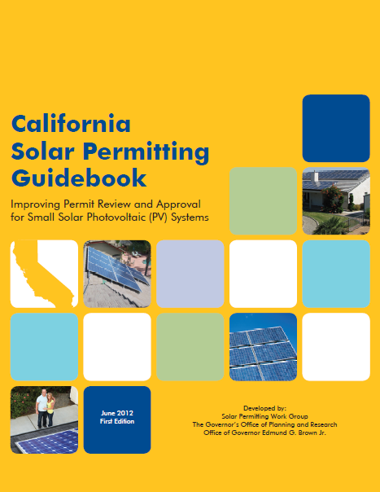
The Solar Permitting Guidebook
Published by the Governor’s Office of Planning and Research (OPR).
Key partner agencies included CA Building Standards Commission, CA State Fire Marshal and CA Housing and Community Development.
Guidebook was developed in consensus with broad set of stakeholders: including building inspectors, local governments and solar contractors.
View the CA Solar Permitting Guidebook here

Slide 7
Snapshot of Guidebook
Current Laws, Regulations and Codes
The Project Approval Process
Recommendations to Improve Local Solar Permitting

Slide 8
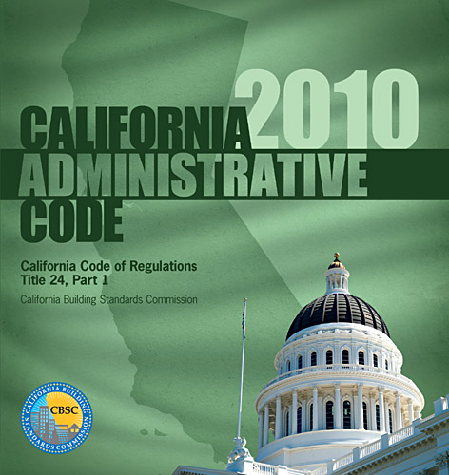
Guidebook Part 1: Current Laws, Regulations and Codes
California’s Statewide Building Standards Code (also known as “Title 24”) contains some requirements for solar PV.
On subjects in which the State Building Standards Code is silent, local governments can adopt ordinances which are reasonably necessary to address local needs.
Local governments can also adopt more stringent ordinances, provided each is accompanied by a specific finding of necessity.
Local governments cannot “unreasonably” prohibit solar energy installations per the California Solar Rights Act.

Slide 9
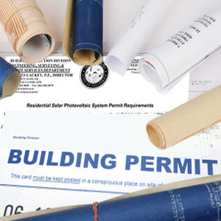
Permit Fees
State Law requires that solar permit fee revenue must only be used to defray the cost of permit processing and enforcement.
Permit fee revenue may not be used for general revenue purposes.
The “valuation method” of calculating solar permit fees, which does not correspond to the costs of administering the permit, is inconsistent with state law.

Slide 10
Guidebook Part 2: The Project Approval Process

Slide 11
Permit Application and Plan Review
The local permitting agency must review permit application to ensure compliance with state and local requirements.
Plan review includes the following subject areas:
Structural safety: Determines if a particular rooftop has the structural support to safely carry the “dead load” of the solar system.
Electrical safety: Components of the PV system (panels, modules, wire, inverters, disconnects, etc.) must comply with the California Electrical Code (CEC) in both intended use and installation.
Roof Classification: Roof must have at least a Class C fire resistance rating for installation.
Planning and Zoning: Local governments have more control over planning of large, commercial solar projects.
Fire Safety: The local government must ensure PV system’s compliance with state fire safety requirements (Note: Sometime this is a separate agency.)

Slide 12
Site Inspection
Last step before final project approval by the local agency.
Inspector from local enforcing agency verifies that installation matches plans submitted by the permit applicant.
Inspector also verifies code compliance, securely fastened items, labels and safety signage.

Slide 13
Local Utility Approval
Contractor/property owner must apply to their electric utility for permission to “interconnect” the solar installation into the electricity grid.
This approval is completely separate from local government approval.
The timeframe for applying for interconnection approval varies by utility; but utility approval process can sometimes occur in parallel with the local agency permit approval process.

Slide 14
Guidebook Part 3 Recommendations for Improving Permitting of Small Solar PV
Guidebook recommends a streamlined permitting process for PV systems under 10KW in size
Why streamline permitting for these sized systems?
The vast majority of rooftop solar systems in most California jurisdictions are small, simple systems under 10kw in capacity.
These small systems are typically simple and resemble one another in engineering.
Efficient review of these systems is enabled by a simplified, standardized permit process.

Slide 15
Local agency steps to streamline permit review for small solar systems
Provide the best information possible, in as many ways as possible:
Post permit information, forms and applications online.
Provide clear and concise explanation of permitting requirements, associated fees and logistical information for permit submittal.
This may include a “submittal checklist” of required permit materials.
Offer a standard electrical plan for use by applicants that allows them to describe the electrical configuration of the project using a “fill in the blanks” approach.
Enable efficient transfer of permit application
Offer the option for applicants to submit their permit via the internet, and to receive permit issuance online as well.
Issue permits over-the-counter or at least set maximum timeframe for permit application review.
Enable payment of permit fees electronically via the internet.

Slide 16
Local agency steps to streamline permit review for small solar systems
Coordinate within and around the jurisdiction
Ensure one local agency coordinates all permit review and approval (avoid multiple required approvals).
Standardize permit requirements and forms across jurisdictional lines.
Train the contractor community
Offer trainings for local contractors about permit and inspection requirements.
Invest time in troubleshooting permitting errors that repeat themselves.

Slide 17
Local agency steps to streamline inspection for small solar PV systems
Communicate Expectations
Provide written explanation of parameters of the inspection
Provides inspection checklist via the internet that outlines major areas of inspection review.
Save time where possible
Offers an inspection appointment the following business day after an inspection is requested on a completed installation.
Offers an estimated inspection windows of under two hours in length and uses email and phone communication to provide information about timing for the inspection.
Coordinate inspections with partners
Coordinates among partner agencies that requiring inspections to allow for either one or concurrent inspections.
Coordinates with the utility to maximize efficiency of the respective inspection visits.

Slide 18
Guidebook offers “Toolkit” for Local Governments
Toolkit consists of “template” documents that local governments can customize for their own use.
Local Information Bulletin: Outlines for permit applicants the necessary steps to secure a solar PV permit.
Standard Plans: “Fill in the blanks” format to describe the electrical configuration of a solar PV system. Toolkit includes version for central inverters and micro inverters.
Example MOU (Memorandum of Understanding): Template agreement that institutionalizes coordination or delegation of permit review between local agencies.
Technical Information Bulletin (single-family residences): Provides a specific local interpretation of current state code requirements for solar PV systems installed on single-family residences.
Technical Information Bulletin (general): Provides a specific local interpretation of current state code requirements for solar PV systems on all buildings (including commercial) in a jurisdiction.

Slide 19
How to Use the Guidebook
Provide installers with standardized permit application forms.
Make application forms, permit requirements, application submittal, fee payment and inspection checklists available online.
Improve interdepartmental communication to increase application review efficiency.
Train inspectors as well as installers to reduce error, need for repetition.

Slide 20
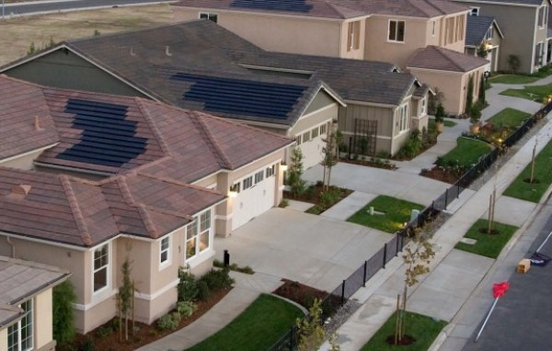
Model Permitting Process: Sacramento, CA
Provides solar checklist, simplified over the counter approval.
1-2 day review process for small-scale PV systems submitted online.
Fee charged as a direct result of labor and resource calculation.
Posted inspection guidelines so that applicants have an idea of what to expect.
Guide to Solar Energy Permits provided as an overview of the city’s solar programs.
Developing all-encompassing “Sacramento Streamline Program” which will make uploading plans, online submittal and navigating any special, location-specific requirements relatively easy.

Slide 21
Model Permitting Process: Berkeley, CA
Application checklist for solar PV panel installation.
Prepared website focused entirely on solar and other renewables.
“Conditions of Building Permit Approval for Solar PV Panel Installations” with circled minor corrections handed out with over-the-counter permit issuance as opposed to a correction letter and re-application process.
Offers free technical support to any Berkeley property owners interested in rooftop solar.
Developed Solar Map to help applicants determine solar potential.

Slide 22
Model Permitting Process: Elk Grove, CA
Over the counter application review, fee payment and permit issuance.
Installer has the ability to track status of plan review.
Expedited response time between inspection request and inspection.
Strong connection with municipal utility (SMUD) allows for limited wait time, quick interconnection.

Slide 23
Need help or resources improving permitting for small solar PV in your community?
Visit
www.opr.ca.gov
to find more resources
Or contact:
Wade.Crowfoot@opr.ca.gov
415-322-5326

